Slide 1
.Pathogenic bacteria
Dr.Munira Ch. Ismail .
Lec.2

Slide 2
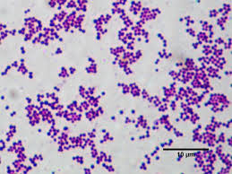
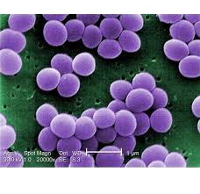
1-GRAM POSITIVE COCCI:
Genus Staphylococci.
Genus Streptococci.
Staphylococci.

Slide 3
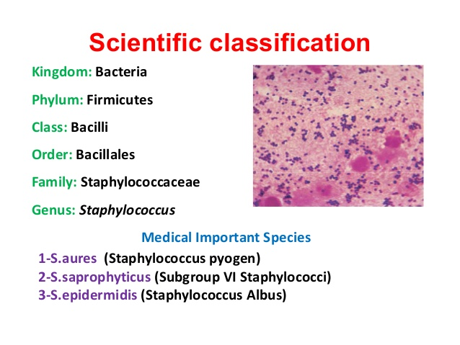

Slide 4
Clinical features:
. Folliculitis:Infection of one hair follicle.
. Curbuncle: Infection of multiple hair follicle and surrounding
skin.
. Cellulitis: Infection of skin and subcutankeous tissue.
. Abscess formation: focal suppuration.
. Mastitis: Infection of breast, especially in lactating mother.
. Bulous impetigo: Crusted superficial skin lesion.
. Pneumonia: Infection of lung parenchyma.
. Empyema: Accumulation of pus in pleural space.
. Osteomyelitis: Infection of bone.
.Endocarditis and meningitis: Infection of heart tissue and characterized by violent nausea, vomiting, and diarrhea.
. Toxic shock syndrome: Caused by toxic shock syndrome toxin-1
produced by S.aureus,
. Characterized by abrupt onset of high fever, vomiting, diarrhea,myalgia, scarlatiform rash,and hypotension with cardiac and renal failure in the most severe disease. Occurs with in 5 days after the onset of menses in young women ,who use tampons.

Slide 5
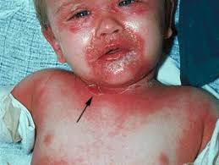
.Staphylococcal scalded skin syndrome: Caused by exfoliativ of S.aureus.
S. saprophyticus: Relatively common cause of urinary tract infections in young women.
S. epidermidis: occasional cause of infection often associated with implanted appliances and devices.
staphylococcal scalded skin syndrome.

Slide 6
Laboratory Diagnosis:
Specimen: Surface swabs, pus, blood, sputum, cerebrospinal fluid.
Smear: Gram positive cocci in clusters, singly or in pairs.
Culture: Grow well aerobically and in a CO2 enriched ordinary media
at an optimal temperature of 350c-370c.
Colony appearance:
S.aureus: characteristically golden colonies.
frequently non-pigmented after over-night incubation.
hemolytic on blood agar plate.
7.5% Nacl containing media is used for mixed flora contaminated
Specimen.
Mannnitol slt agar is used to screen for nasal carriers of S. aureus
S.epidermidis: white colonies, non-hemolytic
S.saprophyticus: may be white or yellow, non-hemolytic.

Slide 7
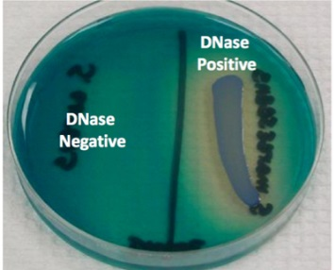
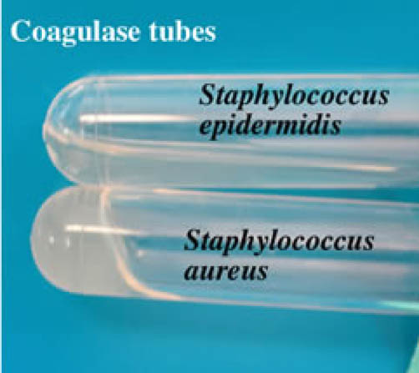
Dnase test
Coagulase test

Slide 8
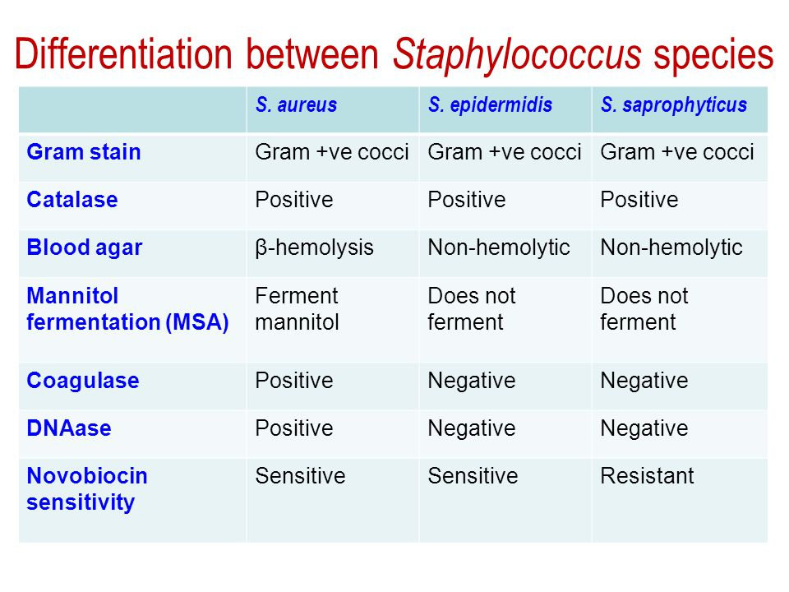
DIFFERENTIATION OF SPECIEs.

Slide 9
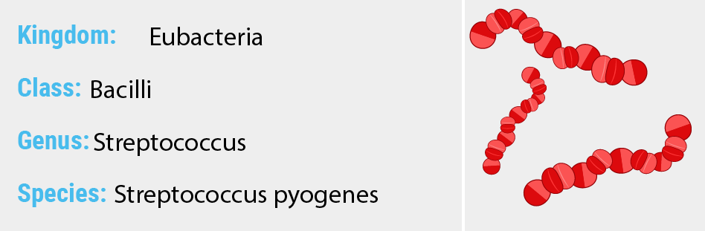
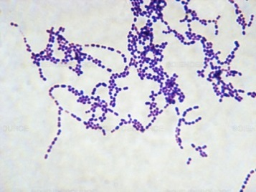
GENUS: STREPTOCOCCI
Streptococci.

Slide 10
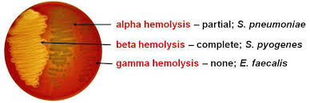
Hemolytic reaction of streptococci.

Slide 11
Lancefield grouping of streptococci:
Streptococci produce group specific carbohydrates(carbohydrates) identified using group specific antiserum.
It is designated A-H and K-V.
The clinically important streptococci are grouped under A,B,C,D,F
and G.
The main species and groups of medical importance
S. pyogenes……... Lancefield group A
S. agalactiae…….. Lancefield group B
Enterococci………Lancefield group D
NB: Viridans streptococci and anaerobic streptococci are not
grouped under Lancefield Classification.

Slide 12
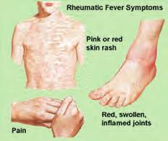

Slide 13
Clinical features:
. Skin infection: Impetigo, cellulitis, erysipelas.
. Scarlet fever.
. Acute streptococccal sorethroat.
. Ear infection: Acute otitis media and mastoiditis.
.Puerperal fever: septicemia originating in the infected uterus.
. Post-streptococcal diseases: Immunological diseases
1. Acute rheumatic fever
Immunological damage to the heart valves and muscle
following
Streptococcal upper respiratory tract infection.
It clinically presents with fever, malaise, migratory nonsppurative polyarthritis, carditis, erythema marginatum and subcutaneous nodules.
2. Post streptococcal acute glomerulonephritis
Immunological damage to the kidney following infection of
skin with streptococci.
It clinically manifests with generalized body edema,elevated bloood pressure, protein and blood in the urine,bloood urea nitrogen retention and low complement level.
. Necrotizing fascitis(Streptococcal gangrene): Extensive and rapidly
spreading necrosis of skin and subcutaneous tissue.

Slide 14
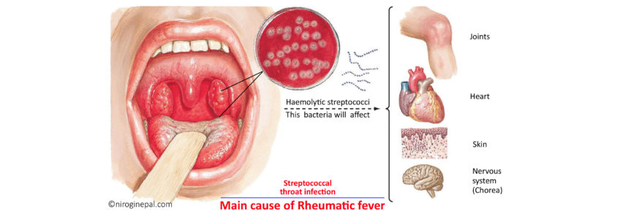
Streptococcus pyogenes: also known as “Group A Strep”, is an infrequent, but usually pathogenic, part of the skin microbiota. Infection with S. pyogenes is the cause of many important human diseases, ranging from mild superficial skin infections to life-threatening systemic diseases including strep throat, toxic shock syndrome, impetigo, scarlet fever, impetigo, and necrotizing fasciitis.

Slide 15
S. agalactiae.
Clinical features:
. Neonatal sepsis, pneumonia, and meningitis.
. Septic abortion.
. Puerperal sepsis.
Enterococci.
Clinical features:
. Frequent cause of nosocomial infection.
. Abdominal abscess.
. Sub acute bacterial endocarditis.
Viridans streptococci.
Eg. Streptococcus mitis.
Streptococcus mutans.
Streptococcus salivarius.
Streptococcus sanguis.
Clinical features:
. Sub acute bacterial endocarditis

Slide 16
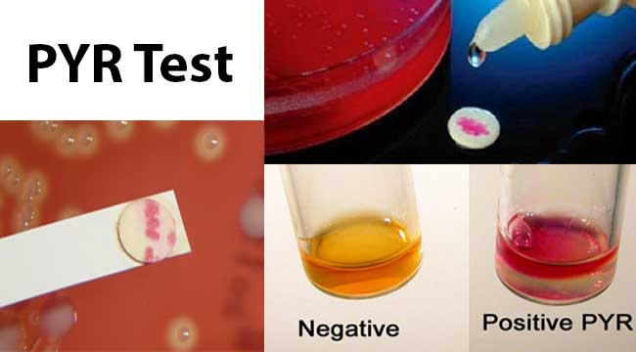
Laboraorty Diagnosis:
Specimen:
S. pyogenes- Throat swab, pus, blood.
S. agalactiae- High vaginal swab of women; blood and cerebrospinal
fluid of new born.
Enterococci- Blood, pus.

Slide 17
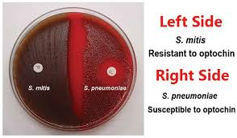
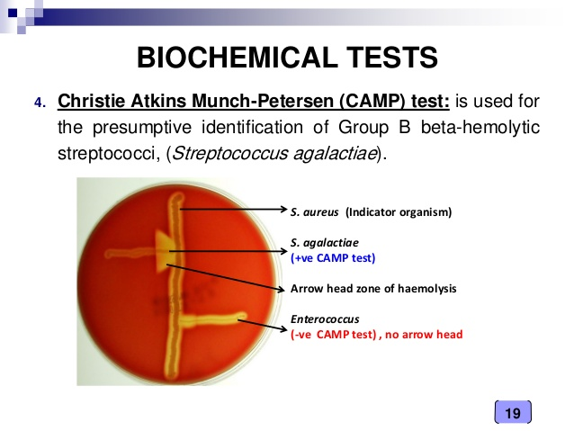

Slide 18
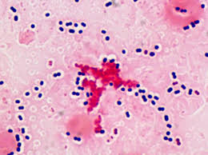
Streptococcus pneumonia.
Found as a normal flora in the upper respiratory tract.
• Fastidious, lancet-shaped gram positive diplococci.
• Possess a capsule of polysaccharide that permits typing with specific antisera.

Slide 19
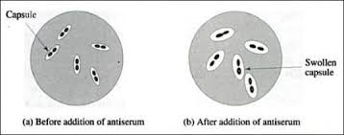
Identified by capsule swelling test(quellung reaction).
. C substance: Cell wall associated antigen.
. Protein M antigen.
. IgA1 protease: Enzyme which cleaves IgA1.
Quellung reaction.

Slide 20
Clinical features:
Lobar Pneumonia. Otitis media.. Sinusitis. Bacteremia………..Meningitis..Endocarditis. Septic arthritis.
Laboratory Diagnosis:
Specimen: Sputum, blood, cerebrospinal fluid, ear discharge and
sinus drainage.
Smears: Lancet-shaped gram positive diplococci.

Slide 21
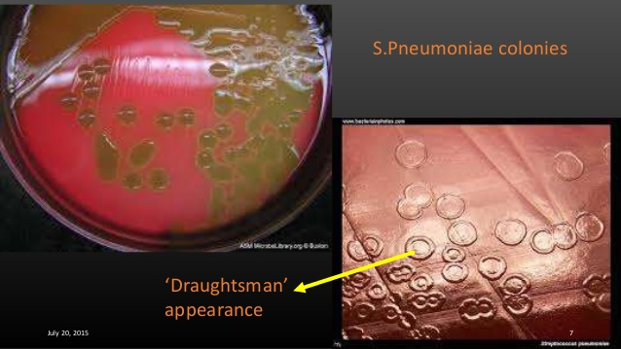
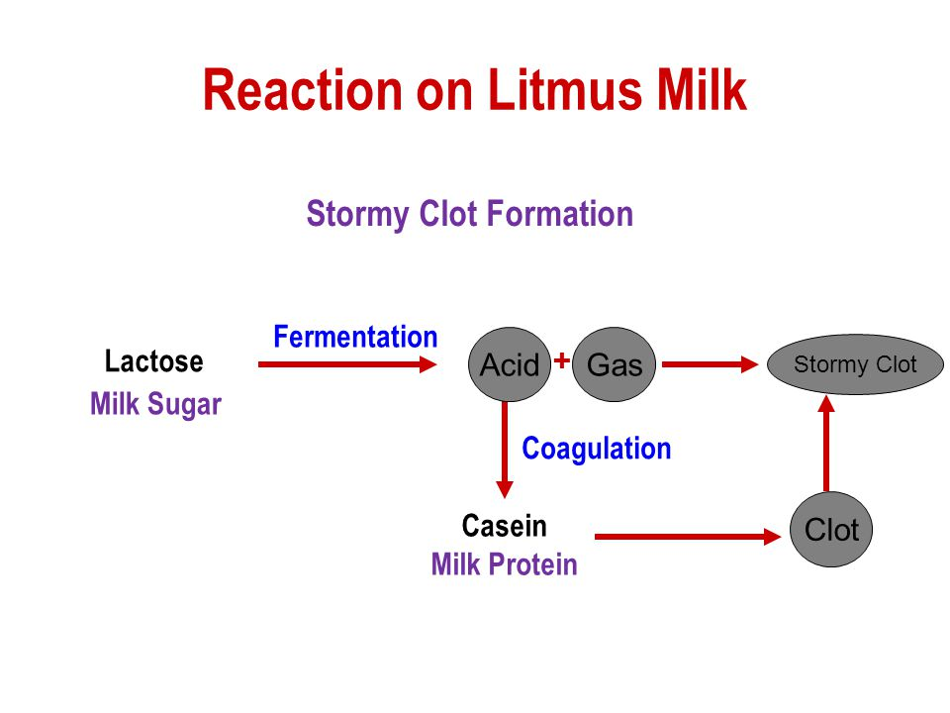
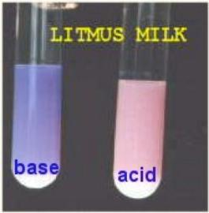

Slide 22


